Slide 1

#LifeKoKaroLift
Android

Slide 2


Course : Android
Lecture On : RecyclerViews & Adapters
Instructor : Rohit Jain

Slide 3
In the last class we covered…
Fragments
Adapters
List View

Slide 4
Today’s Agenda
RecyclerView
Card Layouts
Floating Action Button
Tab Layout

Slide 5
Recylerview
The RecyclerView is a new ViewGroup that is prepared to render any adapter-based view in a similar way. It is supposed to be the successor of ListView and GridView, and it can be found in the latest support-v7 version. One of the reasons is that RecyclerView has a more extensible framework, especially since it provides the ability to implement both horizontal and vertical layouts. Use the RecyclerView widget when you have data collections whose elements change at runtime based on user action or network events.

Slide 6
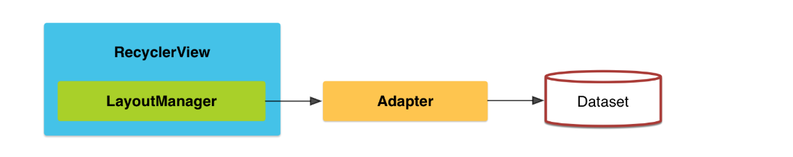
Recylerview
If you want to use a RecyclerView, you will need to work with the following:
RecyclerView.Adapter - To handle the data collection and bind it to the view
LayoutManager - Helps in positioning the items
ItemAnimator - Helps with animating the items for common operations such as Addition or Removal of item

Slide 7
Recylerview
Using a RecyclerView has the following key steps:
Add RecyclerView support library to the Gradle build file
Define a model class to use as the data source
Add a RecyclerView to your activity to display the items
Create a custom row layout XML file to visualize the item
Create a RecyclerView.Adapter and ViewHolder to render the item
Bind the adapter to the data source to populate the RecyclerView

Slide 8
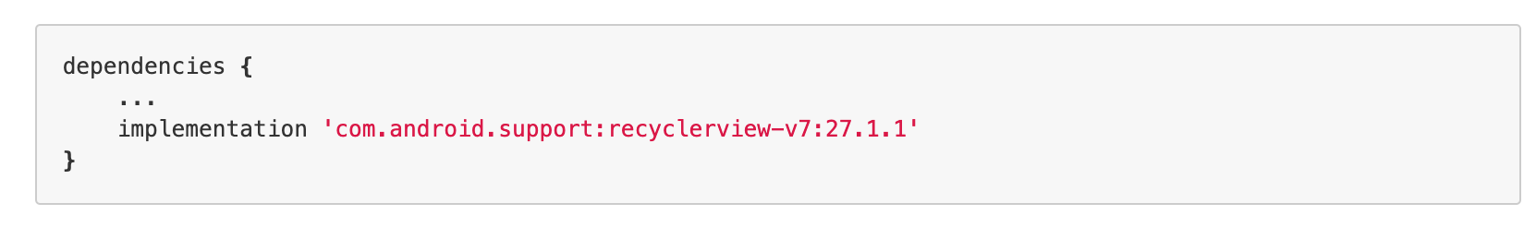
Installation

Slide 9
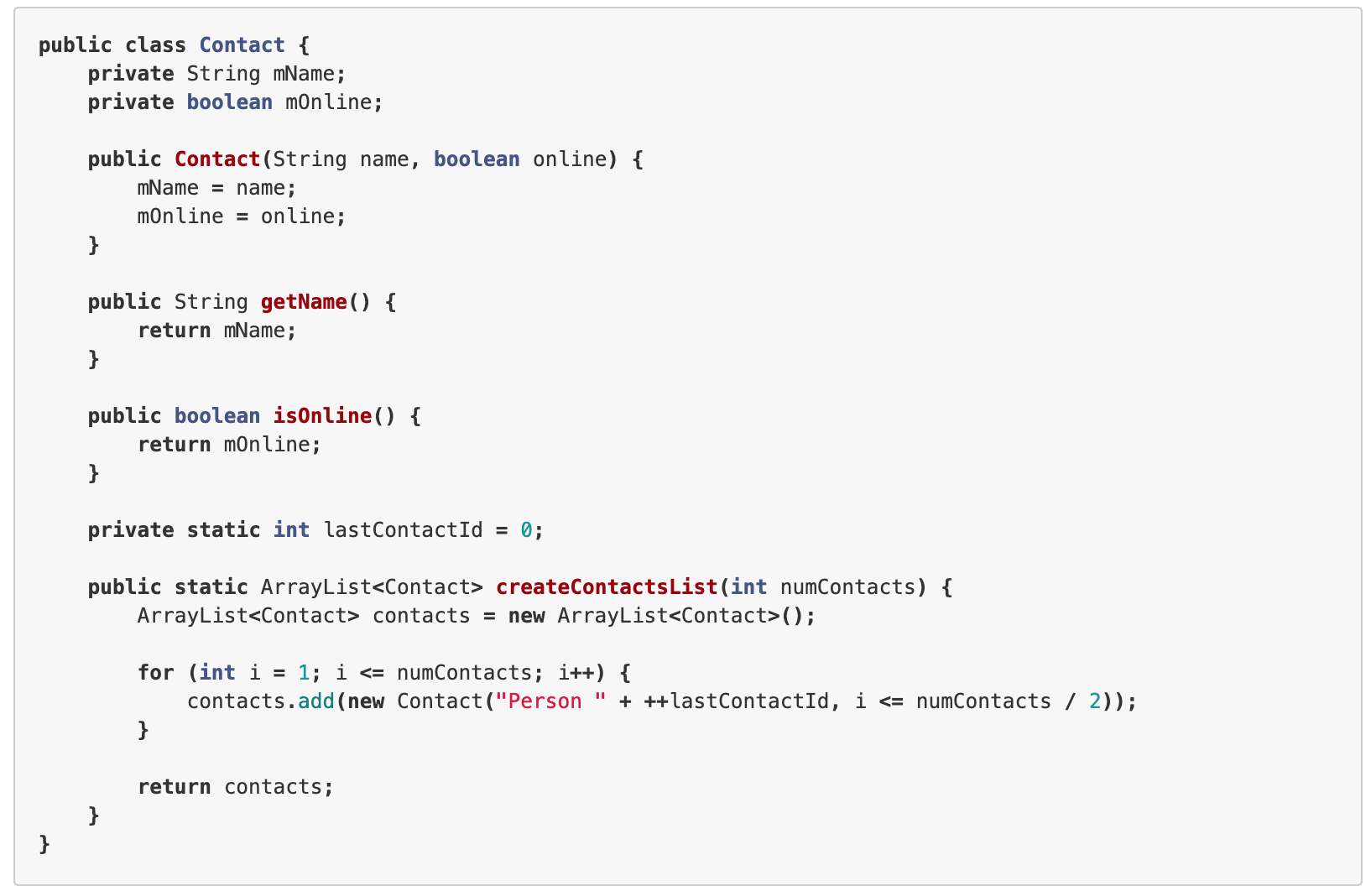
Defining a Model

Slide 10
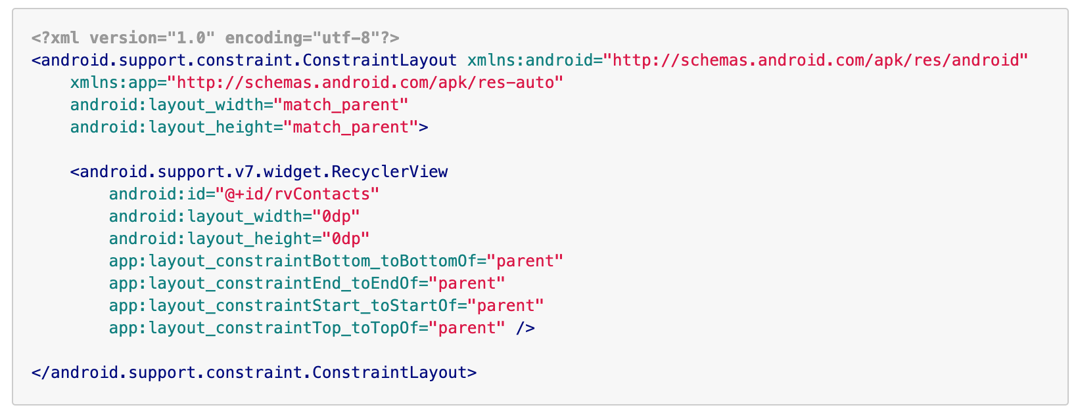
Create the RecyclerView within Layout

Slide 11
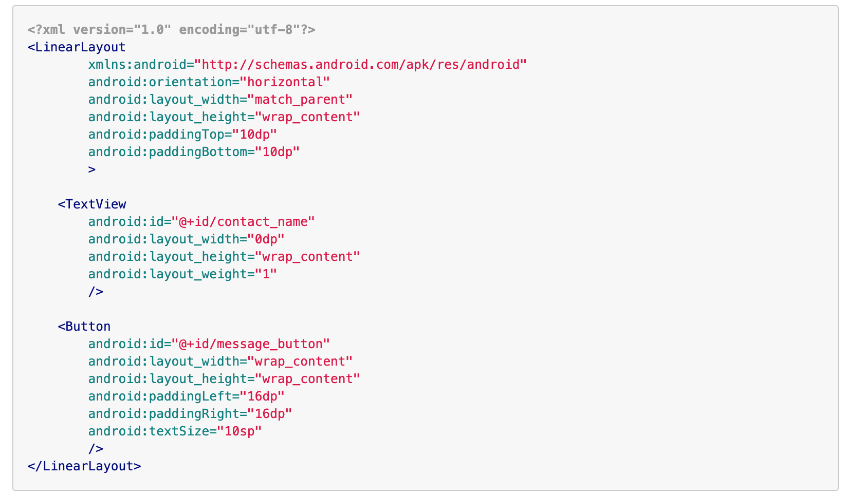
Create a custom row layout

Slide 12
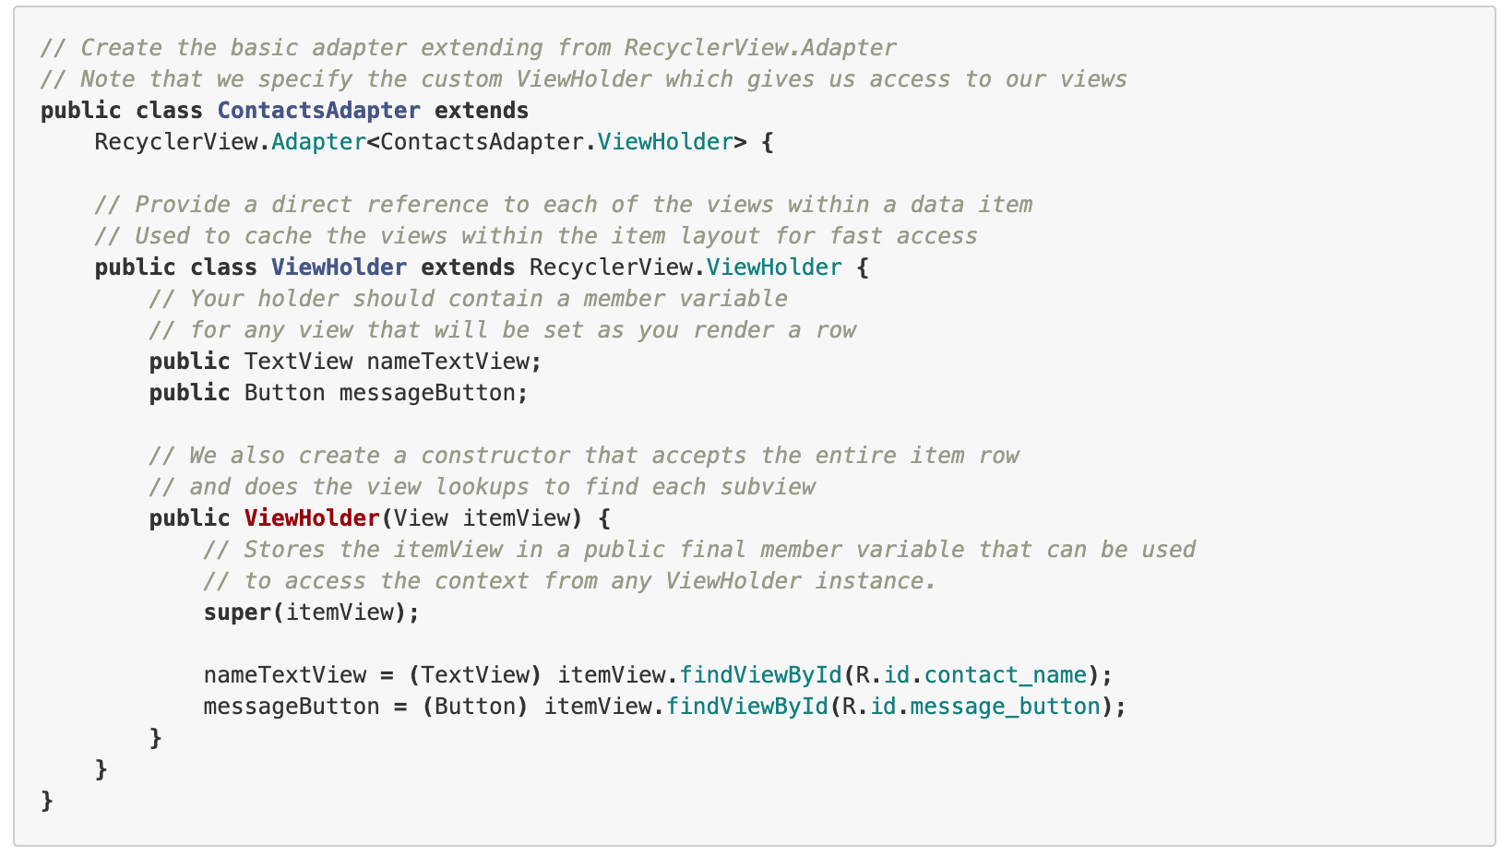
Creating Recylerview.Adapter

Slide 13
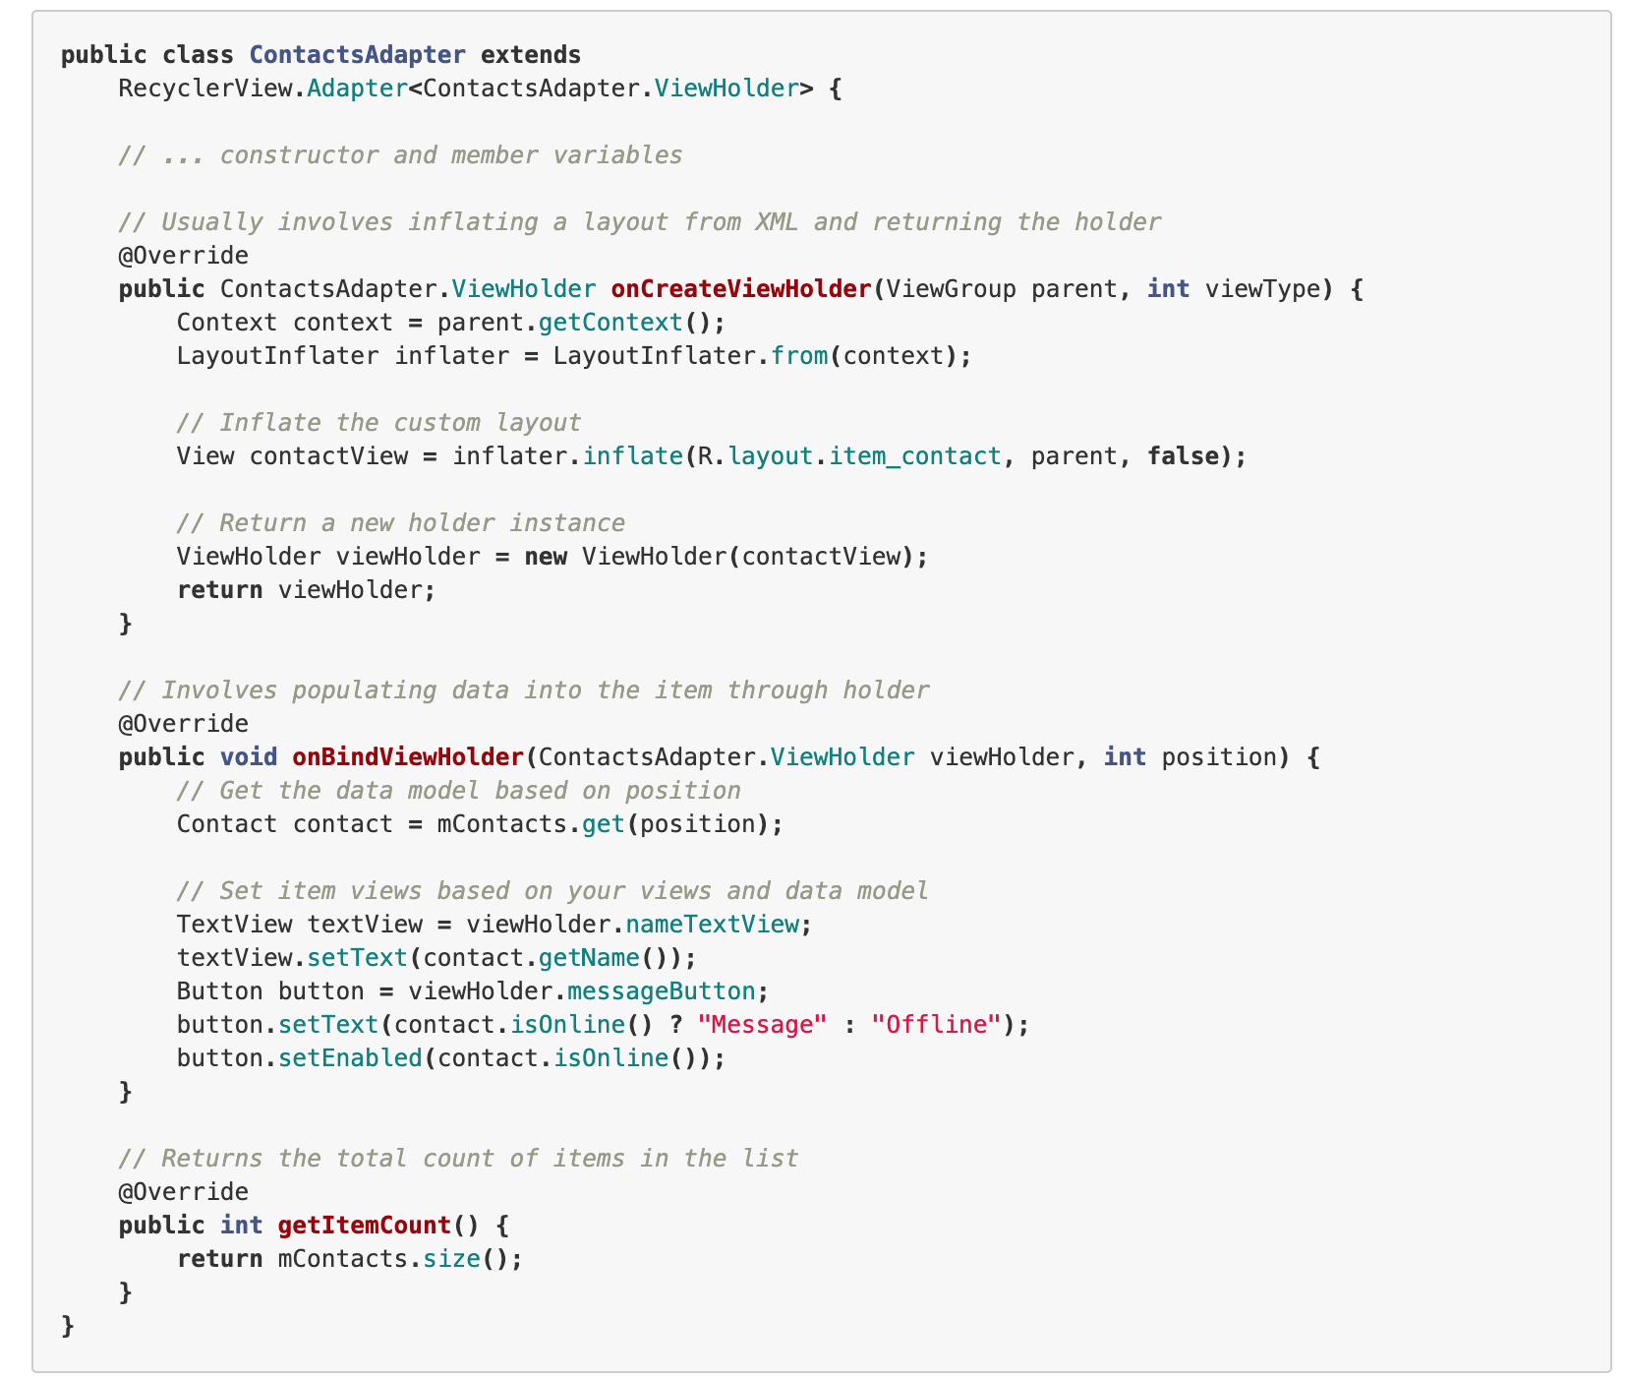
Creating RecylerView.Adapter

Slide 14
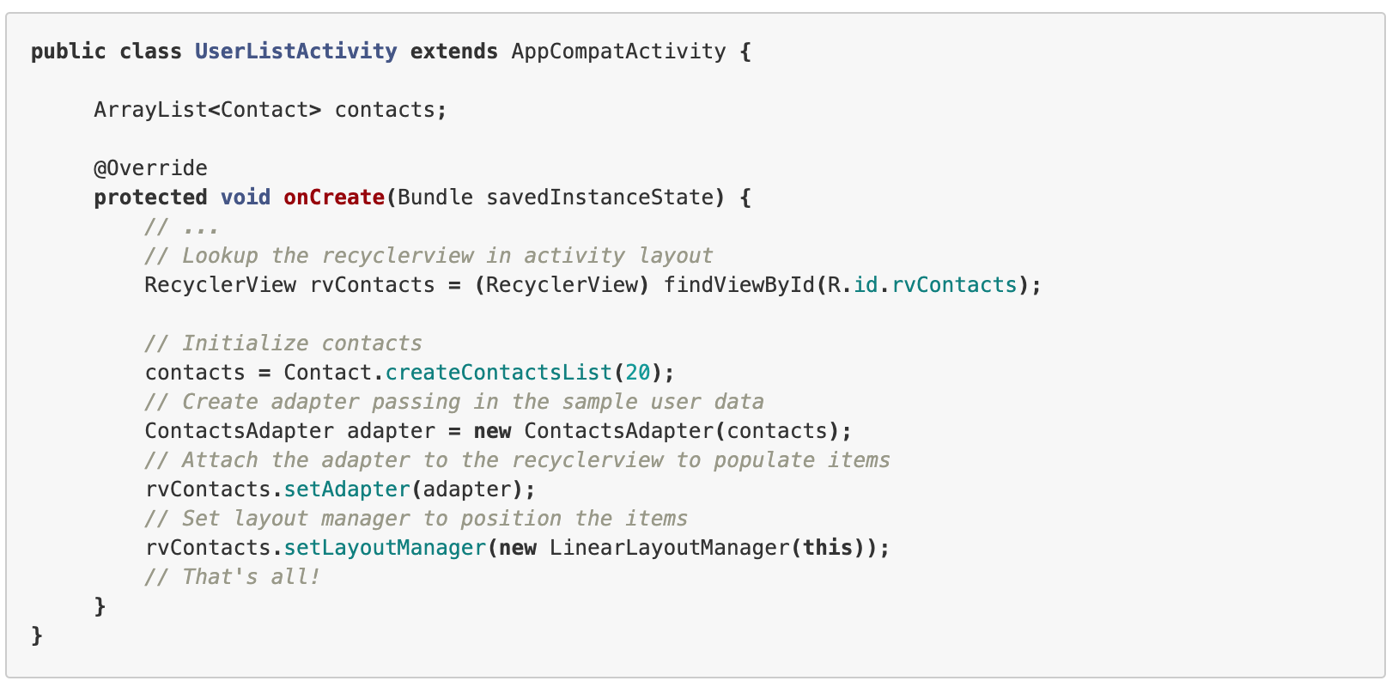
Binding the Adapter to Recylerview

Slide 15
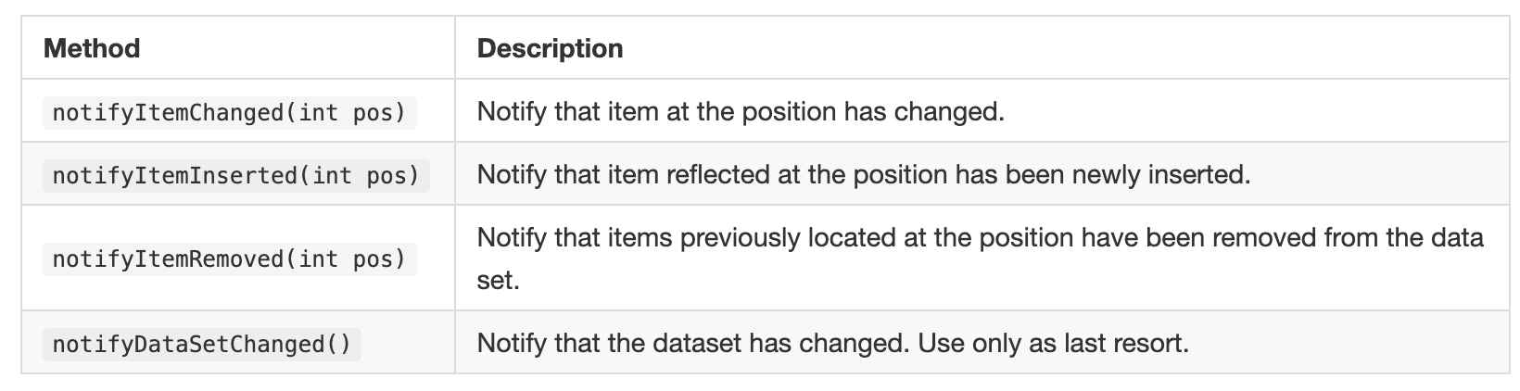
Notifying Adapter
Unlike ListView, there is no way to add or remove items directly through the RecyclerView adapter. You need to make changes to the data source directly and notify the adapter of any changes. Also, whenever adding or removing elements, always make changes to the existing list.

Slide 16
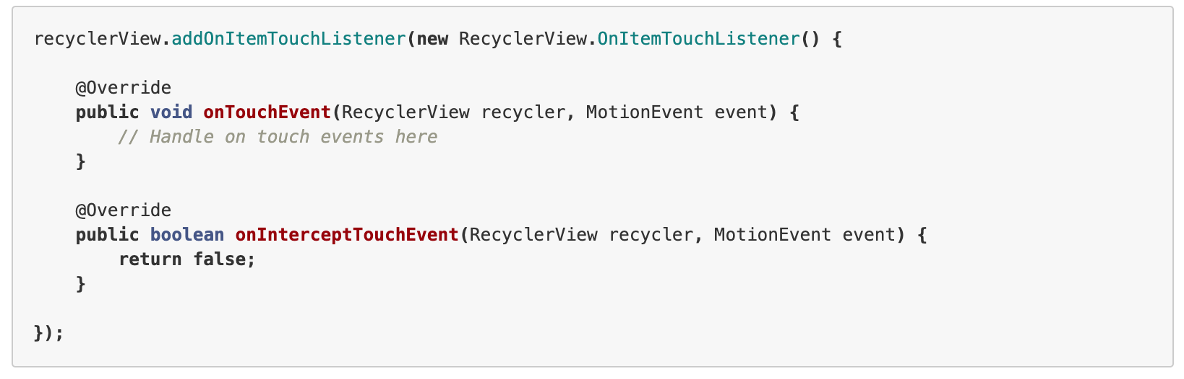
Handling Touch Events

Slide 17
Demo RecyclerView

Slide 18
CardLayout
Android 5.0 introduces a new widget called CardView which essentially can be thought of as a FrameLayout with rounded corners and shadow based on its elevation. Note that a CardView wraps a layout and will often be the container used in a layout for each item within a ListView or RecyclerView.

Slide 19
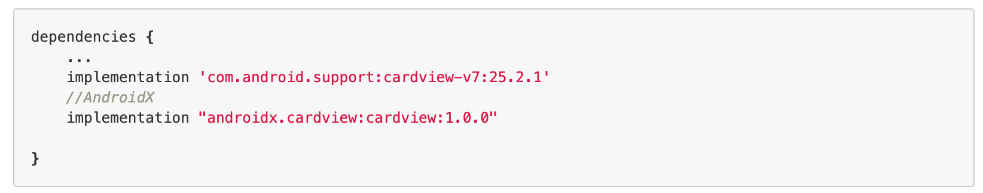
Adding CardView to Dependencies

Slide 20
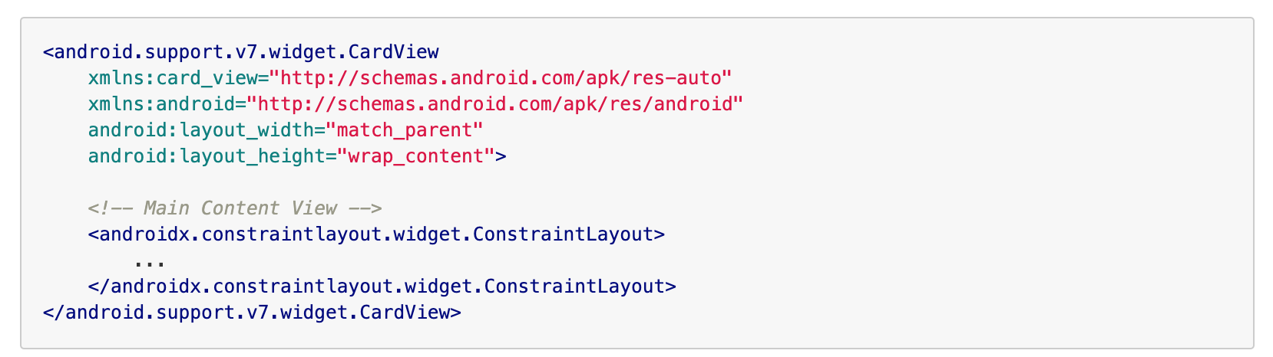
Adding Cardview to XML layout

Slide 21
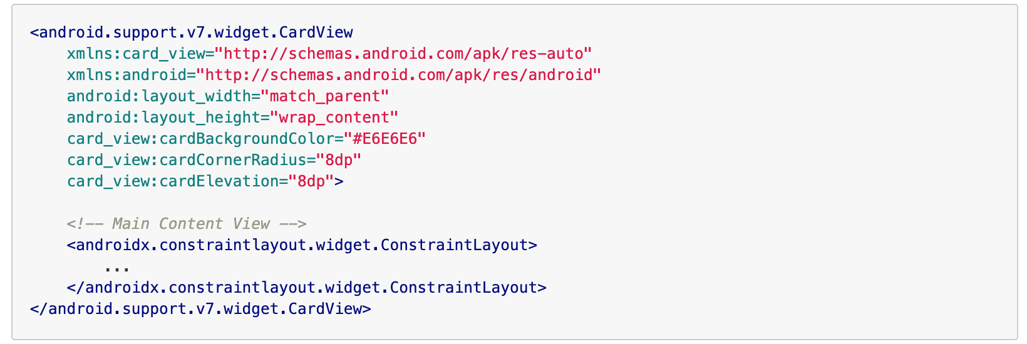
Customizing CardView

Slide 22
Demo CardLayout

Slide 23
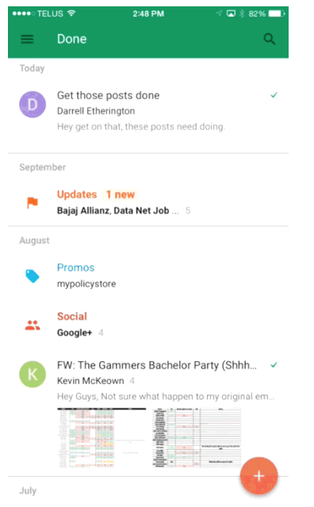
Floating Action Button
Floating action buttons (or FAB) are: “A special case of promoted actions. They are distinguished by a circled icon floating above the UI and have special motion behaviors, related to morphing, launching, and its transferring anchor point.”

Slide 24
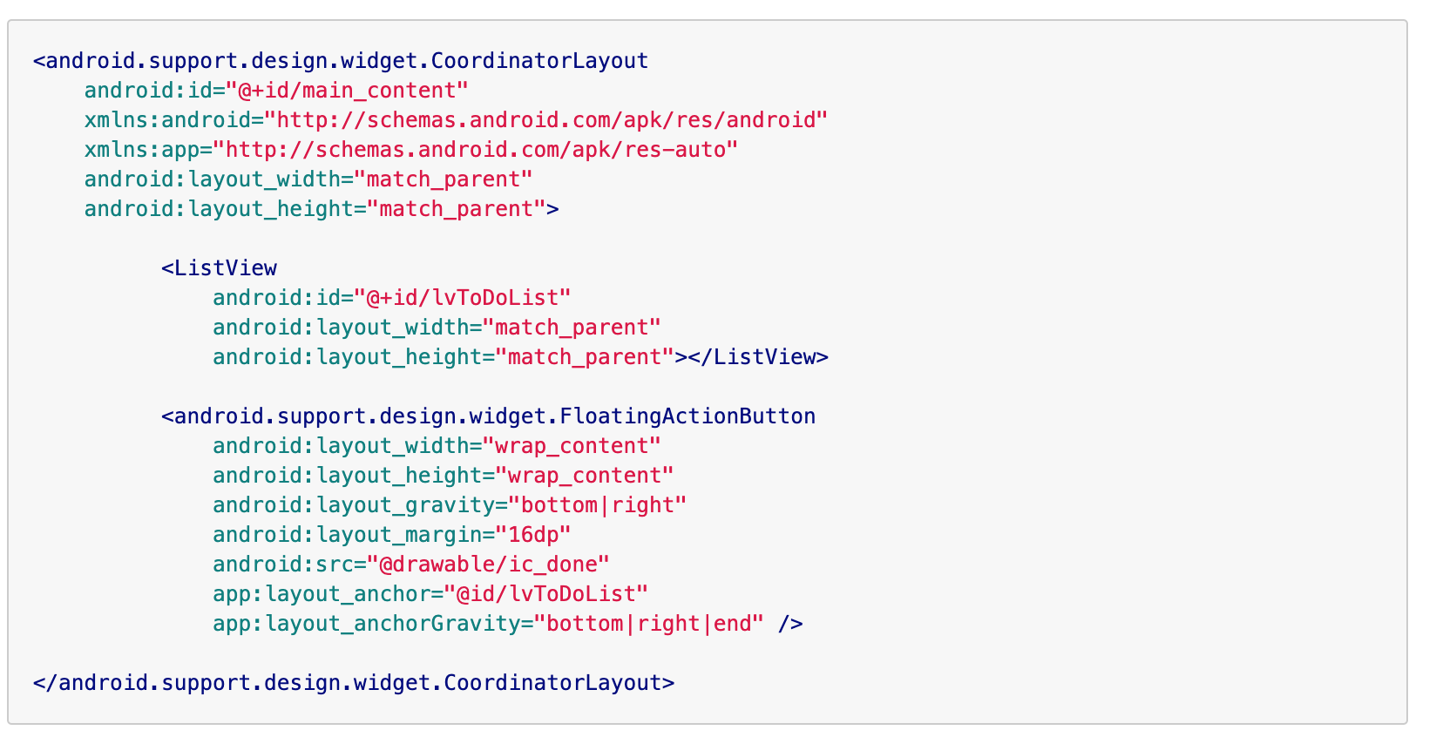
Adding FAB to XML

Slide 25
Demo Floating Action Button

Slide 26
#LifeKoKaroLift
Thank You!

